Slide 1

Network Flow and Circulation with Demands Problem
Presented By:
Prudhvi Kishan & Mitul Rakholiya

Slide 2
Outline
Create graph from input text file in the form of adjacency lists.
Implement Breadth First Search for finding Shortest path between any two nodes in the graph.
Determine Maximum Flow of a graph using Ford-Fulkerson algorithm.
Verify circulation for a given graph.
Test cases generation using Graph generator for multiple graphs
Analysis of test results in terms of time complexity.

Slide 3

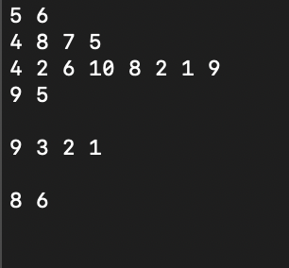
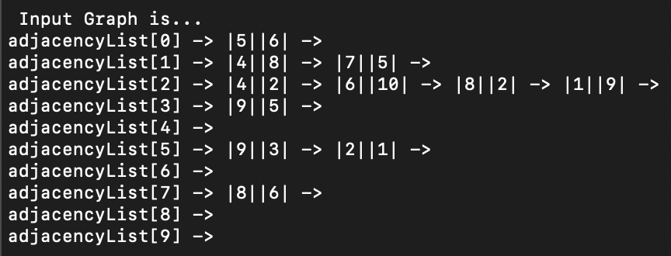
Creation of Graph from txt file input
An array of Linked Lists is used to create an adjacency list.
The input text file consists of edge to which node it is connected to and their corresponding capacities for all nodes.
For each line in the text input file, adjacency list edge is created to i^{th} value with (i+1)^{th} value as capacity between the nodes.

Slide 4
Breadth First Search
BFS is a graph traversal algorithm that starts from a selected node and traverse the entire graph, considering the neighbor nodes.
The process is continued until all nodes are visited in the graph.
Assign parent for each node traversed to keep track of the path used for reaching the destination.
A visited flag is maintained for each node to avoid traversing the same node again, thus finding the order of nodes in which traversal is done.
Time Complexity for this algorithm is O(E+V).

Slide 5
BFS Implementation - 1
BFS(G,s)
for each vertex u € G.V — {s}
u.color = WHITE For each node v,
u.d = ∞ v.d: the minimum distance to s
u.π = NIL v.π: the parent of v to reach s
s.color = GRAY and s.d = 0 and s.π = NIL v.color:
Q = Ø WHITE: v has not been discovered yet
ENQUEUE(Q,s) GRAY: v has been discovered, but not its neighbor
while Q ≠ Ø BLACK: v and its neighbors have been discovered. It will not be visited any more
u = DEQUEUE(Q)
for each v € G.Adj[u]
if v.color == WHITE
v.color = GRAY and v.d = u and v.π = u
ENQUEUE(Q, v)
u.color = BLACK
.
s

Slide 6
BFS Implementation - 2
BFS (G) //Where G is the graph - adjacency list
let Q be queue.
let nodeVisited be Boolean array //To avoid visiting a node more than once
let parent be an Integer array //To store parent of a node
Q.add( source edge ) //Inserting source in queue && //Mark source as visited
while ( Q is not empty and size of Q is greater than Zero)
//Removing that vertex from Q, whose neighbors will be visited now
currentNode = Q.poll( ) currentNode value is taken from the source
for all neighboring edges of currentNode in Graph G //processing all the neighbors of currentNode //destination edge is assigned to nodeNumber
if edge is not visited
Q.add( edge details ) //Stores the new edge in the Q to further visit its neighbor
mark the above edge as visited. //Put true in visited at the end.
store the edge as currentNode’s parent.
return (nodeVisited[sink]) //when the destination is reached

Slide 7
Edmonds–Karp algorithm
Edmonds–Karp algorithm is one of the algorithm that computes the maximum flow in a flow network.
Maximum flow - Maximum amount of flow from source to sink.
Residual graph is created from the Original graph with initial flow as zero.
A Residual graph indicates how much more flow is allowed in each edge in the network graph.
The Residual graph is obtained by Augmenting paths from source to sink.
If there are no augmenting paths possible from source to sink, then the flow that we have at that point is the Maximum Flow.
Time Complexity - O(|V||E|²)

Slide 8
Edmonds–Karp Implementation
FordFulkerson(Graph G): //Where G is the original graph
maxFlow = 0 //initialize maxFlow to zero
s = getSource and t = getTarget Nodes // Source Inbound is Zero. Target Outbound is zero
residualGraph = G //store original graph as residual graph
while (BFS(residualGraph,s,t)): //check for augmenting path from source to sink
maxFlow += pathFlow // store minimum capacity path flow
Update residual network graph
return maxFlow

Slide 9
Updating Residual graph
Updating residual graph consists of following steps:
For every edge in the augmenting path, a value of minimum capacity in the path is subtracted from all the edges of that path.
An edge of equal amount is added to edges in reverse direction for every successive nodes in the augmenting path.

Slide 10
9
1
9
4
10
9
9
1
10
4
15
10
1
14
15
1
8
1
9
0
15
2
8
5
10
7
7
1
9
5
6
15
10
4
3
6
Max Flow = 9 +
1 +
8 = 18

Slide 11
Circulation Problem
For this Max-flow problem is considered again, without a source and a sink.
Each node has a demand or supply, i.e., the flow a node can take or give, respectively.
Demand if d(v) > 0
Supply if d(v) < 0
A common source and a common sink are added to the graph at the beginning and end such that all supplies are connected to the source, and all demands to sink.
Supplies and demands are assigned to respective edges from source and to sink.

Slide 12
Circulation Problem Implementation
Add source(S) & sink(T)
Add edges (S, v) for all supply nodes (d(v)<0) with edge capacity |-d(v)|
Add edges (v, T) for demand nodes (d(v)>0)) with capacity d(v)
Find Max flow with Ford-Fulkerson algorithm
Circulation problem is only possible when:
The Sum of Demands is equal to the Sum of Supplies in a graph.
It is feasible if and only if it is equal the max-flow value f.
If any of the above condition fails, then there is no circulation possible in the given graph.

Slide 13
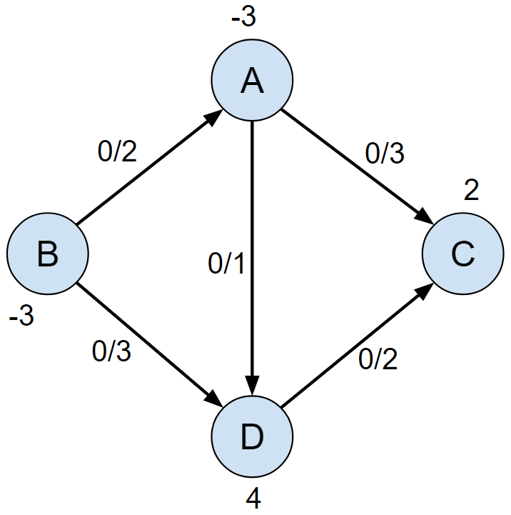
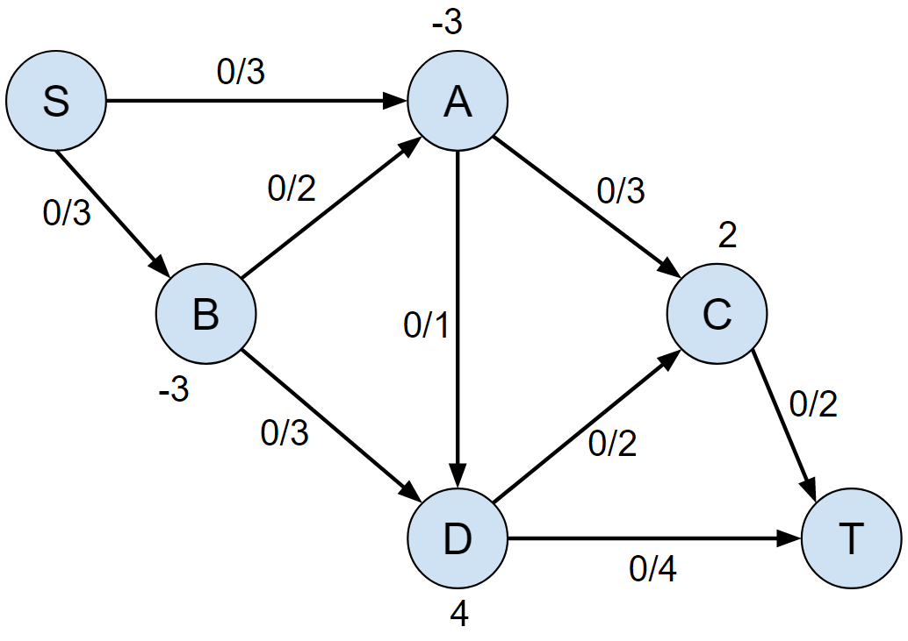
Example

Slide 14
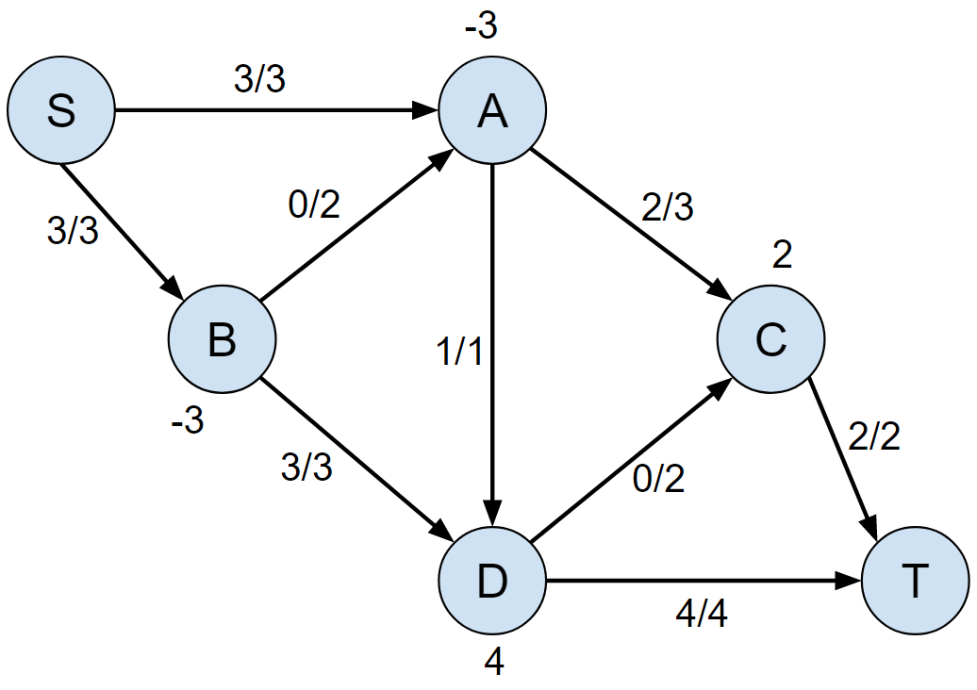
Apply Ford Fulkerson
Graph has Circulation
Sum of Supplies = 6
Sum of Demands = 6
Max Flow = 6

Slide 15
Graph Test cases algorithm:
This algorithm generates graph files for the programs, which is a random graph generator.
The number of vertices starts from 5 and the loop runs till 10000 generating graphs for every case. The program picks a random number of edges for the graph at around 50 percent of the maximum number of edges for a complete graph
i.e., (numOfVertices*(numOfVertices - 1)/2).
The above formula is obtained by below statement: A complete graph has an edge between any two vertices. You can get an edge by picking any two vertices. So if there are n vertices, then there are nC2=n(n−1)/2 edges.
Below conditions are considered while generating the graph:
No edge is to be created once an edge exists between two vertices.
No outgoing edges from the destination vertex (last vertex)
No incoming edges to the source vertex (first vertex)
No self-loop to a vertex.
All these conditions must be satisfied then the graph is generated.
The graph is written to a .txt file and later converted to adjacency lists by a Graph program to be used in BFS and Ford Fulkerson algorithms.

Slide 16
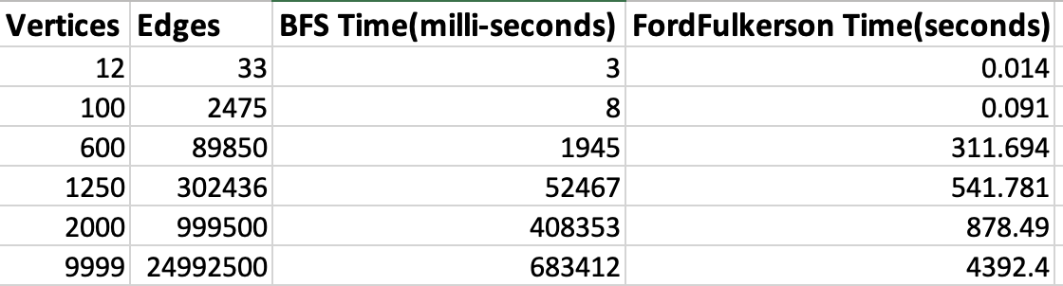
Sample Run Results
2328 test cases are considered for BFS and FFA.
Graphs with 10, 100, 500, 1000, 2000, 5000 and 10000 vertices are generated (0.5*maxEdges).
Run time is measured for each text input.

Slide 17
BFS graph – (Run time in milli-seconds vs E+V)

Slide 18
Ford Fulkerson - (Run time in seconds vs V*E²)

Slide 19
DEMO

Slide 20
